Slide 1
JavaScript Events

Slide 2
Outline
Introduction to Events
Event Listeners
The Event Object
Event Propagation
Form Events

Slide 3

Introduction to Events

Slide 4
What is an Event?
JavaScript Events are signals fired by the browser when something happens on your page.
A user action, a browser action or a state change
Events allow JavaScript to respond to things happening in real time, making web pages interactive & dynamic
Every event has an event type – a string identifying what kind of thing happened.
E.g. “click”, “keydown”, “load”
JavaScript responds to events through event handlers – functions that are registered to run when a specific event occurs on a specific element.

Slide 5
Event Types | Sample
Event Type | Description | Events
Mouse Events | Fired in response to mouse interactions | “click” “dblclick” “mouseenter” “mouseleave” “mouseover” “mousedown” “mouseup”
Keyboard Events | Fired in response to keyboard interactions | “keydown” “keyup”
Page lifecycle Events | Fired by the browser in response to the page’s loading state | “DomContentLoaded” “load” “beforeunload” “unload”
More information about events can be found here: DOM events - Web APIs | MDN

Slide 6
Event Listeners

Slide 7
Event Listeners
An event listener is a procedure or function in a computer program that waits for an event to occur.
Note: This is similar to the ‘Observer’ design pattern.
A listener is an effect loop that is programmed to react to an input or signal
An event listener will fire when a user performs some specified action (the event to “listen for”)

Slide 8
Event Listeners
The addEventListener(type, callback) function is the standard way to register a function to run when a specific event occurs on an element
This function takes two required arguments:
Event type: The type of event to listen for, as a string value.
Callback: the function that runs when the event fires.
The callback function automatically receives the event object as its first argument (more on this later)
Multiple event listeners can be applied to the same element, for the same or different event types.
Note: There is an old style of event handler binding using a property assignment syntax; however, this only allows for a single handler per event type.
Ex: element.onclick

Slide 9
Event Listeners
Another style of adding event listeners is through inline HTML handlers.
Ex: <button onclick=“doSomething()”>
This mixes JavaScript logic directly into HTML markup, making code harder to maintain and separate.
A previously registered Event listener can be removed using the function: removeEventListener(type, callback)

Slide 10
The Event Object

Slide 11
Event Object
Every event listener callback automatically receives an event object as its first argument when the event fires
The event object contains details about the event
What happened?, where it happened?, and on which element?
Event Object details:
event.type: a string identifying the type of event that fired (e.g. “click”, “keydown”)
event.target: the specific element that triggered the event
event.currentTarget: The element that the listener is attached to (this will differ from event.target when events bubble through the DOM)
event.preventDefault(): cancels the brower’s default behavior for the event (e.g. preventing a link from navigating or a form from submitting)
Keyboard Event Properties:
event.key: returns the value of the key pressed (e.g. “Enter”, “a”)
event.code: returns the physical key location on the keyboard (“KeyA”, “Space”)
Mouse Event Properties:
event.clientX / event.clientY: returns the mouse pointer’s position relative to the viewport.
event.pageX / event.pageY: returns the mouse pointer’s position relative to the full page.

Slide 12
Event Propagation

Slide 13
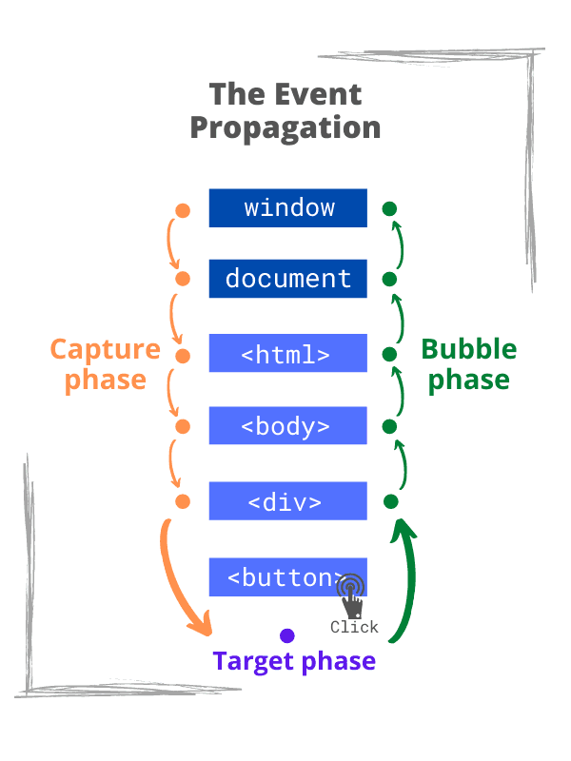
Event Propagation
Event propagation describes the order in which event listeners are triggered when an event fires on a nested element
Propagation happens in three phases: capture, target, and bubble
Capture phase: the event travels downward from the window through the DOM tree toward the target element
Target phase: the event reaches the element it originated on and fires any listeners attached directly to it
Bubble phase: the event travels upward from the target element back through its ancestors toward the window.

Slide 14
Event Propagation
By default, addEventListener() registers listeners in the bubble phase – the capture must be opted into explicitly.
To listen during the capture phase, pass a third argument of true (or { capture:true } ) to the addEventListener() call
event.stopPropagation() halts the event’s journey through the DOM – listeners on ancestor (or descendant, in capture) elements will not fire
event.stopImmediatePropagation() stops propagation AND prevents any remaining listeners on the same element from firing.

Slide 15
Form Events

Slide 16
Form Events
Form events fire in response to user interaction with form elements
submit: fires when a form is submitted; attached to the <form> element, not the submit button; default behavior sends a request and reloads the page.
event.preventDefault(): is almost always used with submit to intercept submission and handle it with JavaScript instead (e.g. validation, or sending data without a page reload)
input: fires every time the value of an input, textarea, or select changes.
ideal for real-time feedback such as live character counts or instant validation
change: fires when an input's value changes and the element loses focus;
For checkboxes and radio buttons, fires immediately on selection
focus: fires when an element receives focus (user clicks it)
blur: fires when an element loses focus (user clicks away)
commonly used to trigger validation after the user finishes with a field
You can read a field’s current value via event.target.value for text-based inputs, and event.target.checked for checkboxes and radio buttons

